Slide 1

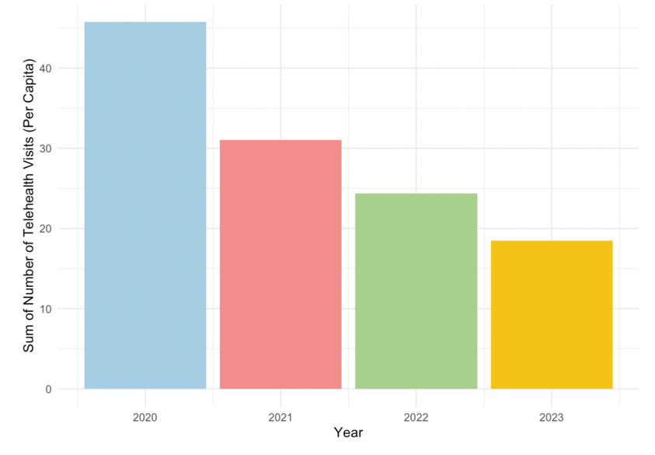
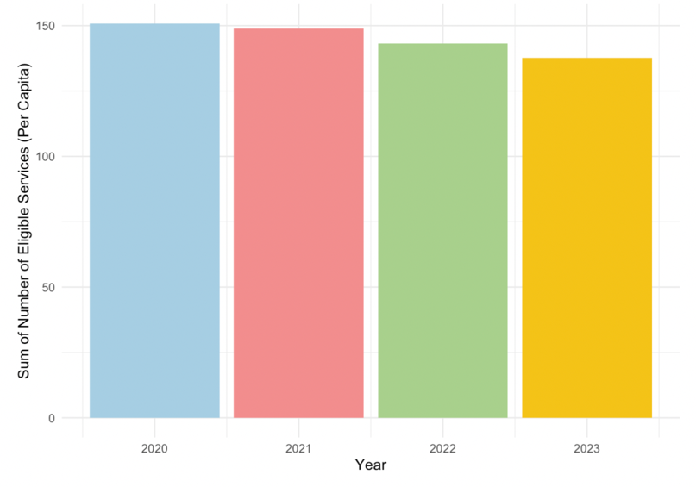
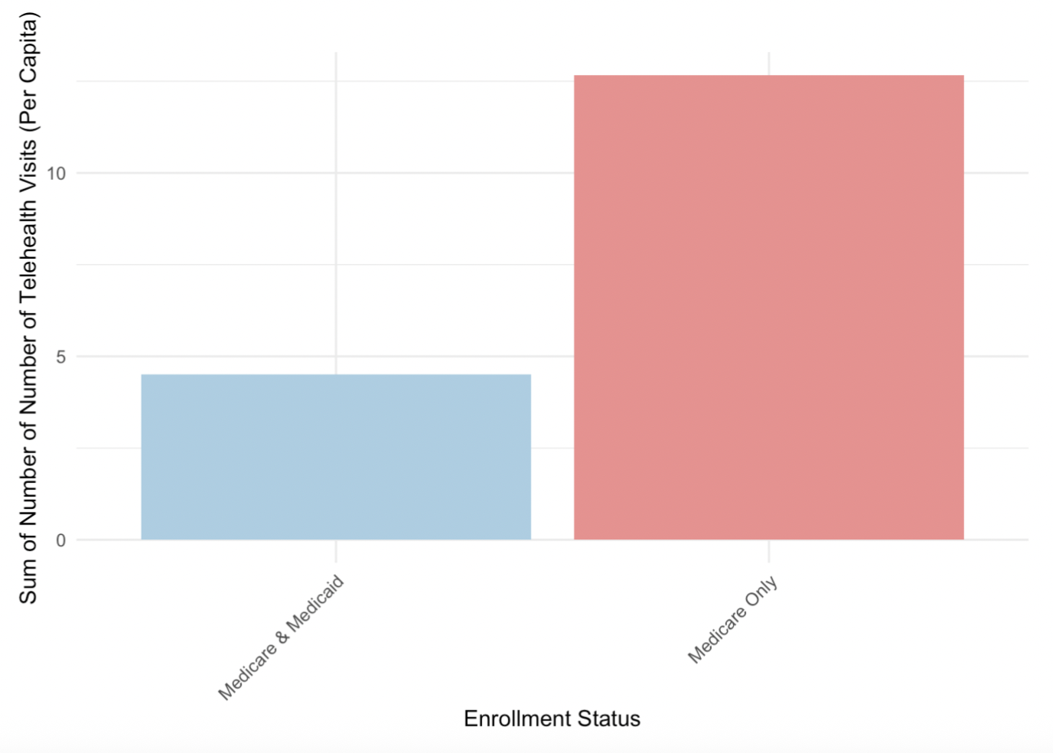
Factors impacting the use of telehealth for Medicare and Medicaid members in 2020-2024
Jessica Coomber
Data Analytics 401
Introduction
Research Aim:
Understand the factors impacting the use of telehealth visits for Medicare and Medicaid members
Dataset:
Medicare Telehealth Trends dataset (Centers for Medicare & Medicaid Services)
US Census Bureau
Transit Report Card from Transportation for America
Fixed Effect Analysis:
Assesses the relationship between the variables and the number of telehealth visits (per capita).
Controls for state and year.
Implications:
Results explore potential socioeconomic barriers to telehealth access
Increasing the use of telehealth services for populations who are lacking vs accessing eligible services.
Support targeted interventions to improve equitable access to care.
Figure 1: Telehealth Visits by Year
Table 1: State and Year Fixed Effects on Various Factors impacting the Number of Telehealth Visits (Per Capita)
Table 2: Variance Inflation Factors (VIF)
Variable | No Fixed Effect | State Fixed Effect | State and Year Fixed Effect
Vehicles Owned | 0.066** | 0.121*** | 0.122***
 | (0.009) | (0.021) | (0.021)
Transit Spending Per Capita | 0.000*** | 0.005*** | 0.005***
 | (0.000) | (0.001) | (0.001)
With Internet | -0.076*** | -0.108*** | -0.103***
 | (0.009) | (0.013) | (0.014)
Number of Hospitals | -45.313*** | -1670.351*** | -1657.032***
 | (5.089) | (323.434) | (323.677)
Number of Physicians | 2.211*** | 92.439*** | 93.079***
 | (0.213) | (14.899) | (14.912)
Percent Below Poverty Level | -0.025*** | -0.022 | -0.021
 | (0.003) | (0.015) | (0.015)
Num.Obs. | 19330 | 19330 | 19330
State Fixed Effects | No | Yes | Yes
Year Fixed Effects | No | No | Yes
R² | 0.092 | 0.139 | 0.139
Variable | VIF
Vehicles Owned | 7.70
With Internet | 6.55
Number of Physicians | 2.09
Hospitals Count | 1.75
Transit Spending Per Capita | 1.69
Percent Below Poverty Level | 1.66
Results
<5 suggests low multicollinearity
Table 2 variables are mostly low so coefficients in the Fixed Effect are accurate and reliable.
Figure 2: Eligible Services
(With Potential for Telehealth Use) by Year
Discussion
Eligible services are missing potential for increase access with the use of telehealth
Several key factors influencing telehealth usage have been identified in the fixed effect model
The use of telehealth by Medicare and Medicaid members is affected by more than just whether internet is available
There are many factors which could be used to represent economic status, technology access and appointment access
Medicare and Medicaid members in this study is used to represent a population who is facing more barriers.
Further research should be done on populations included other levels of insurance coverage.
Methods
Fixed effect model
Control for time invariant variables (state and year)
Factors in the fixed effect model:
The Number of Vehicles Owned
Transit Spending Per Capita
Having Internet Access
Number of Hospitals
Number of Physicians
Poverty Level
Evaluate the fit of the model:
R² represents how well the model explains variation in number of telehealth visits for each fixed-effect group.
Variance Inflation Factor (VIF):
Test for multicollinearity
When independent variables are highly correlated
If so, variables could be capturing overlapping aspects of economic status.
Note: Statistical significance for coefficients is shown by *p < 0:10 **p < 0:05 ***p < 0:01 ****p < 0:001. Standard Errors are included in parenthesis.
Results
R²
No fixed effect R² = 0.092. (Number of telehealth visits is explained little by the variables)
With fixed effect R² = 0.139 (Explains more of the variation)
Vehicles Owned
Higher number of vehicles owned is associated with more telehealth visits.
Likely better financial status and accessibility to resources.
Transit Spending
Higher amount spent on transit is associated with slightly more telehealth visits.
Urban areas have higher access to broad band internet vs rural areas (Ching-Ching, 2018).
Internet access
Surprisingly, more internet is associated with fewer telehealth visits.
Widespread internet, 95% of U.S. households have at least one type of computer (Liu, 2024).
Number of Hospitals and Number of Providers
More hospitals is associated with less telehealth which could be because of more in person availability. These have potential to be done with telehealth (Ashwood, 2017).
More providers means there are more appointment available, including telehealth.
Percent below poverty level
Higher poverty is associated with fewer telehealth visits
Figure 3: Telehealth Visits by Enrollment Status
Works Cited
Ashwood, J. and Mehrotra, Ateev and Cowling, David and Uscher-Pines, Lori. (2017). Direct-to-consumer telehealth may increase access to care but does not decrease spending. Health Affairs, 36(2)https://doi.org/10.1377/hlthaff.2016.1130
CMS Program Statistics - OEDA (2025). Medicare Telehealth Trends. [Data set]. Centers for Medicare & Medicaid Services. https://catalog.data.gov/dataset/medicare-telemedicine-snapshot
Ching-Ching, Claire Lin et al.. (2018). Telehealth in health centers: Key adoption factors, barriers, and opportunities. Health Affairs, 37(12) https://doi.org/10.1377/hlthaff.2018.05125
Liu, L. (2024). Computer and Internet Use in the United States 2021. https://www.census.gov/newsroom/press-releases/2024/computer-internet-use-2021.html

